Slide 1
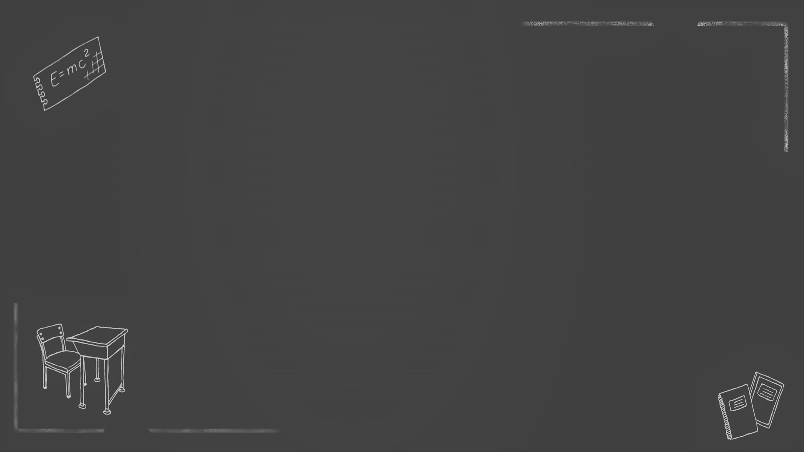
(2020 11 宁波 1模)
假如你是李华，正在英国留学。下周你所在的社区将举行以中医为主题的社区活动，目前正在招募志愿者。请你用英文向主办方提出申请，内容包括：
1.提出申请；2. 介绍自己的优势；3. 期待加入。
注意：1. 词数80左右；2. 可以适当增加细节，以使行为连贯。
参考词汇：中医traditional Chinese medicine (TCM)或中药的重要性
Dear sir or madam,
I am Li Hua, an international student from China. __________________________________________ _______________________________________________
I am looking forward to hearing from you.
Sincerely ,
Li Hua
Notes:
www.515ppt.com

Slide 2
Puzzle 1:
key words:
社区活动
以中医为主题
的社区活动
招募志愿者
a community activity
a community activity themed traditional Chinese medicine
a community activity on /concerning TCM
recruit volunteers
( some volunteers are wanted /needed )

Slide 3
Puzzle 2: Strengths in para.2
What are your strengths ?
1.your interest in TCM
/your knowledge of TCM
2.your personal experience
3.your language ability /communication skills
4.your quality/personality
?
outgoing / enthusiastic /warmed -hearted/ responsible /reliable /devoted/confident /determined...

Slide 4
Dear Sir or Madam,
I am Li Hua, an exchange student from China. I hear that volunteers are needed for the coming community activity themed TCM . I can hardly wait to apply for the position. Initially, I was born into a doctor's family of TCM. I was deeply interested in it at an early age . Later I spent 4 years studying TCM and it enables me to have a good knowledge of it. I can not only explain the theory to the people around, but also tell the stories behind it. Besides, I have a good command of English, so I have no difficulty communicating with others. Additionally, I am enthusiastic and responsible, so I believe I am perfectly qualified for the job as a volunteer. because all these qualities are mentioned above, I can say with certainty that I am the right person you are looking for. I would appreciate it if you could take my application into consideration. Looking forward to your early reply.
Yours, Li Hua

Slide 5
Polishing
Employ some advanced words and phrases
I was born into a doctor's family of TCM , I was deeply interested in it at an early age. Later I have spent 4 years studying TCM at university and it enables me to have a good knowledge of TCM.
had a great passion for
/ was passionate about
I was born into a doctor's family of TCM, I ____________ it at an early age and later I _______________ TCM for 4 years at university and it enables me to ___________ some knowlege of TCM.
was keen on
have majored in
accumulate
become greater in number or quantity

Slide 6
Tip: Employ v-ing/v-ed form(doing/done...)
I was born into a doctor's family of TCM , and I was keen on it at an early age. I have majored in TCM at university for 4 years and it enables me to accumulate some knowlege of it.
_________a doctor's family of TCM, I was keen on it at an early age and have majored in TCM at university for 4 years,_________ me to accumulate some knowlege of it.
Born into
enabling

Slide 7
I was born into a doctor's family of TCM , and I was keen on it at an early age. I have majored in TCM at university for 4 years ,enabling me to accumulate some knowlege of it.
_________________ the dense atmosphere of TCM family, I was keen on it at an early age and have majored in TCM at university for 4 years, enabling me to accumulate some knowlege of it.
I have been exposed to

Slide 8
Employ v-ing/v-ed form (doing/done/having done...)
be immersed in
I have been exposed to the dense atmosphere of TCM family
and I am passionate about TCM , so I take a course of it at college and I have accumulated some knowledge of it.
________________________ the dense atmosphere of TCM family, I am passionate about TCM , so I take a course of it at college and I have accumulated some knowledge of it．
Having been exposed to
Immersed in /Having been immersed in the dense atmosphere of TCM family ,I am passionate about TCM ...

Slide 9
Use inversion
I can not only explain the theory to the people around, but also tell the stories behind them.
____________________ the theory to the people around, but also tell the stories behind them.
Not only can I explain

Slide 10
Use inversion
I hear that some volunteers are wanted for the coming community activity themed TCM , I can hardly wait to apply for the position.
Hearing that some volunteers are wanted for the coming community activity themed TCM, ________________ to apply for the position.
hardly can I wait

Slide 11
I have a good command of English, so I have no difficulty communicating with others.
I have a good command of English, __________ it possible for me to communicate with others ____________________
which makes
without any difficulty.
I have a good command of English, _______ it possible for me to communicate with others without any difficulty.
making

Slide 12
Use adjs
Use special sentences (do/does/did + V原)
I am enthusiastic and responsible and I believe I am perfectly qualified for the job as a volunteer.
________________________, I ____ believe that I am perfectly qualified for the job as a volunteer.
Enthusiastic and responsible
do

Slide 13
插入语
Enthusiastic and responsible , I do believe I am perfectly qualified for the job as a volunteer.
Enthusiastic and responsible, I am perfectly qualified for the job as a volunteer.
I bet,

Slide 14
I am quite qualified that I have a good command of English, so I have no difficulty communicating with others.
What makes me qualified
_________________ is that my good command of English makes me have no difficulty communicating with others.
What qualifies me

Slide 15
My previous abundant experience as a volunteer distinguishes
me from others .
_________________________ is my previous abundant experience as a volunteer .
What distinguishes me from others

Slide 16
with +n.+ doing/done /todo
Because all these qualities are mentioned above, I cam say with certainty that I am the right person you are looking for.
______________________________ , I can say with certainty that I am the right person you are looking for.
With all these qualities mentioned above

Slide 17
Dear Sir or Madam,
I am Li Hua, an exchange student from China. Hearing that volunteers are recruited for the coming community activity themed TCM , hardly can I wait to apply for the position. Born into a doctor's family of TCM, I was keen on it at an early age and have majored in TCM at university for 4 years, enabling me to accumulate some knowledge of it. Not only can I explain the theory to the people in the community, but also tell the stories behind it. Besides, What qualifies me most is that my good command of English makes me have no difficulty in communicating with others. Additionally, enthusiastic and responsible, I do hold the belief that I am perfectly qualified for the job as a volunteer. With all these qualities mentioned above, I can say with certainty that I am the right person you are looking for. I would appreciate it if you could take my application into consideration. Looking forward to your early reply.
Yours, Li Hua

Slide 18
Dear Sir or Madam,
I am Li Hua, an exchange student from China. Knowing that volunteers are recruited for the coming community activity themed TCM , hardly can I wait to apply for the position. Exposed to the dense atmosphere of TCM family and having majored in it at university for 4 years, I can explain the theory as well as the stories behind professionally and throughly . Also , my proficiency in English enables me to get knowledge across to people around easily/Also, a good command of English qualifies me in smoothly communicating what I know to others. As an Enthusiastic and responsible activist in voluntary work, I bet I'm the perfect candidate for the position. I would appreciate it if you could take my application into consideration. Looking forward to your early reply. 99words
Yours, Li Hua

Slide 19
Tips :
1: some advanced words and phrases
2: v-ing/v-ed form
3: inversion
4: attributive clauses
5: adjs as adverbial
6: do/does/did + V原
7: noun clauses
8: with +n.+ doing/done /todo

Slide 20
假若你是李华，是校学生会主席。你校交换生Chris想了解学校的迎新活动，请你回复邮件，内容包括：
1 活动时间地点
2活动安排
3欢迎参加
注意:1.词数80左右;
2.可适当增加细节,以使行文连贯

Slide 21
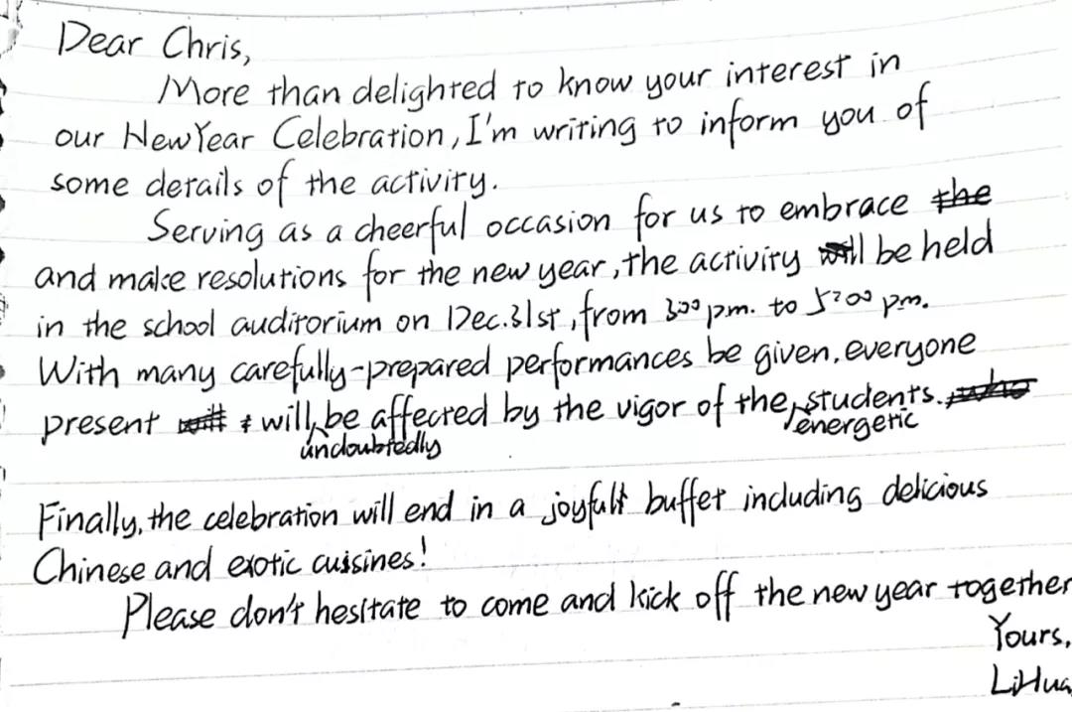

Slide 22
New Year Celebration并非专有名词，建议改成New Year celebrations；inform sb of sth为“（正式）通知、告知”的意思，用在此处与两人的关系不符，建议简化为I'm writing to tell you...即可。第二段首句，用分词结构巧妙地融入了举办活动的时间和地点，但逗号前的内容，更多的是像对这次活动的定义，而非具体内容，hence irrelevant。建议保留时间地点，删去定义，增加活动内容.第二段第二句，重点落在了“在场的观众会受到演员热情洋溢的表扬的影响”上，而将活动的介绍放在了with+n构成的状语中，有点本末倒置之嫌，且有语法错误，应为with many carefully-prepared performances to be given, ......。建议具体化performances的具体内容，而且需将它放在主句，而不是屈居状语中。

Slide 23
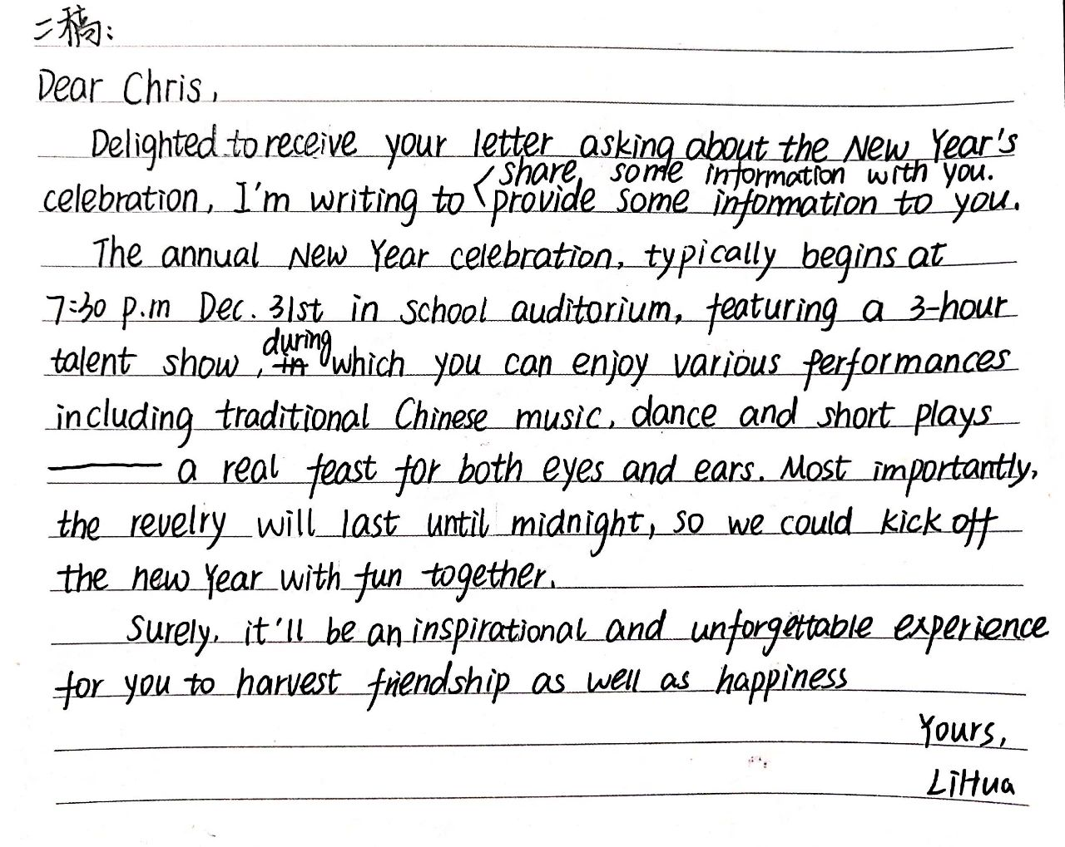

Slide 24
Dear Chris,
You asked, in your last letter, about New Year celebrations in our school. I'm writing to share some information.
The annual New Year celebration, which typically kicks off at 7:30 P.M. Dec 31st in our school auditorium, features a three-hour talent show, during which you can enjoy various performances including traditional Chinese music, dance and short plays--a feast for both the eyes and ears. More importantly, the revelry/carnival will continue well into midnight, when we can begin a countdown to embrace the new year together. Sounds fun, isn’t it?
It'll surely be an inspirational and unforgettable experience where you're bound to harvest friendship as well as happiness.

Slide 25
假定你是李华，你校英语协会招聘志愿者，接待来访的外国中学生。请你写信应聘，内容包括： 1.口语能力 2.相关经验
3.应聘目的 注意：1.词数80左右 2.可以适当添加细节，以使行文连贯
Notes:
www.515ppt.com

Slide 26
adding some details
A Good
Practical Writing
no spelling and grammar mistakes
sincere tone
neat handwrting
tense
covering all points
proper linking words
various sentence patterns
Notes:
www.515ppt.com

